Slide 1




Design a PHONEBOOK Consisting of All Features Supported
Divya(23csu103)
Divyanshi(23csu105)

Slide 2

Content
Introduction to PhoneBook
Contacts-Delete,Search,Display
Benefits of Application
Output
Contacts-Add,Edit
Code Structure

Slide 3
Introduction to PhoneBook
What is PhoneBook??
A console-based application for managing personal or professional contacts.
Written in Java, utilizing object-oriented principles.
Purpose:
Simplify the process of storing, retrieving, and managing contact information.

Slide 4
Benefits of the Application
Easy Contact Management: Add, edit, delete, and search contacts efficiently.
Custom Display Options: View contacts in alphabetical or customized order.
Error Handling: Validates inputs and provides user-friendly error messages.
Scalability: Built using Java, making it adaptable to additional features.

Slide 5
Code Structure
Components
Contact Class:
Stores contact details (name, phone number, email, address).
PhoneBook Class:
Manages contacts using a HashMap.
Main Method:
Menu-driven interface for user interaction.

Slide 6
Adding Contacts
Add Contact Flow
Input name, phone number, email, and address.
Validates:
Duplicate name.
10-digit phone number.
Adds contact if validation passes.
Code Snippet
public void addContact(String name, String phoneNumber, String email, String address) {
if (contacts.containsKey(name)) {
System.out.println("Error: Duplicate contact.");
} else if (!isValidPhoneNumber(phoneNumber)) {
System.out.println("Error: Invalid phone number.");
}
else
{
contacts.put(name, new Contact(name, phoneNumber, email, address));
System.out.println("Contact added successfully.");
}
}

Slide 7
Editing Contacts
Edit Contact Flow
User specifies contact name to edit.
Inputs new details (or skips with Enter).
Validates phone number if provided.
Updates contact information.
Code Snippet
public void editContact(String name, String phoneNumber, String email, String address) {
Contact contact = contacts.get(name);
if (contact == null) {
System.out.println("Error: Contact not found.");
} else {
contact.phoneNumber = phoneNumber != null ? phoneNumber : contact.phoneNumber;
contact.email = email != null ? email : contact.email;
contact.address = address != null ? address : contact.address;
System.out.println("Contact updated successfully.");
}
}

Slide 8
Deleting Contacts
Delete Contact Flow
User specifies contact name to delete.
Removes contact from the list.
Notifies user of success or error.
Code Snippet
public void deleteContact(String name) {
if (contacts.remove(name) != null) {
System.out.println("Contact deleted successfully.");
} else {
System.out.println("Error: Contact not found.");
}
}

Slide 9
Searching Contacts
Search Contact Flow
User enters a query (name, phone, email, or address).
Searches for matches in all fields.
Displays matching contacts or a "not found" message.
Code Snippet
public void searchContacts(String query) {
boolean found = false;
for (Contact contact : contacts.values()) {
if (contact.name.contains(query) || contact.phoneNumber.contains(query) ||
(contact.email != null && contact.email.contains(query)) ||
(contact.address != null && contact.address.contains(query))) {
System.out.println(contact);
found = true;
}
}
if (!found) {
System.out.println("No contacts found for the given query.");
}
}

Slide 10
Displaying Contacts
Display Contact Flow
User chooses alphabetical or default order.
Sorts contacts (if needed).
Displays contact details sequentially.
Code Snippet
public void displayContacts(boolean alphabeticalOrder) {
List<Contact> contactList = new ArrayList<>(contacts.values());
if (alphabeticalOrder) {
contactList.sort(Comparator.comparing(contact -> contact.name));
}
for (Contact contact : contactList) {
System.out.println(contact);
}
}

Slide 11
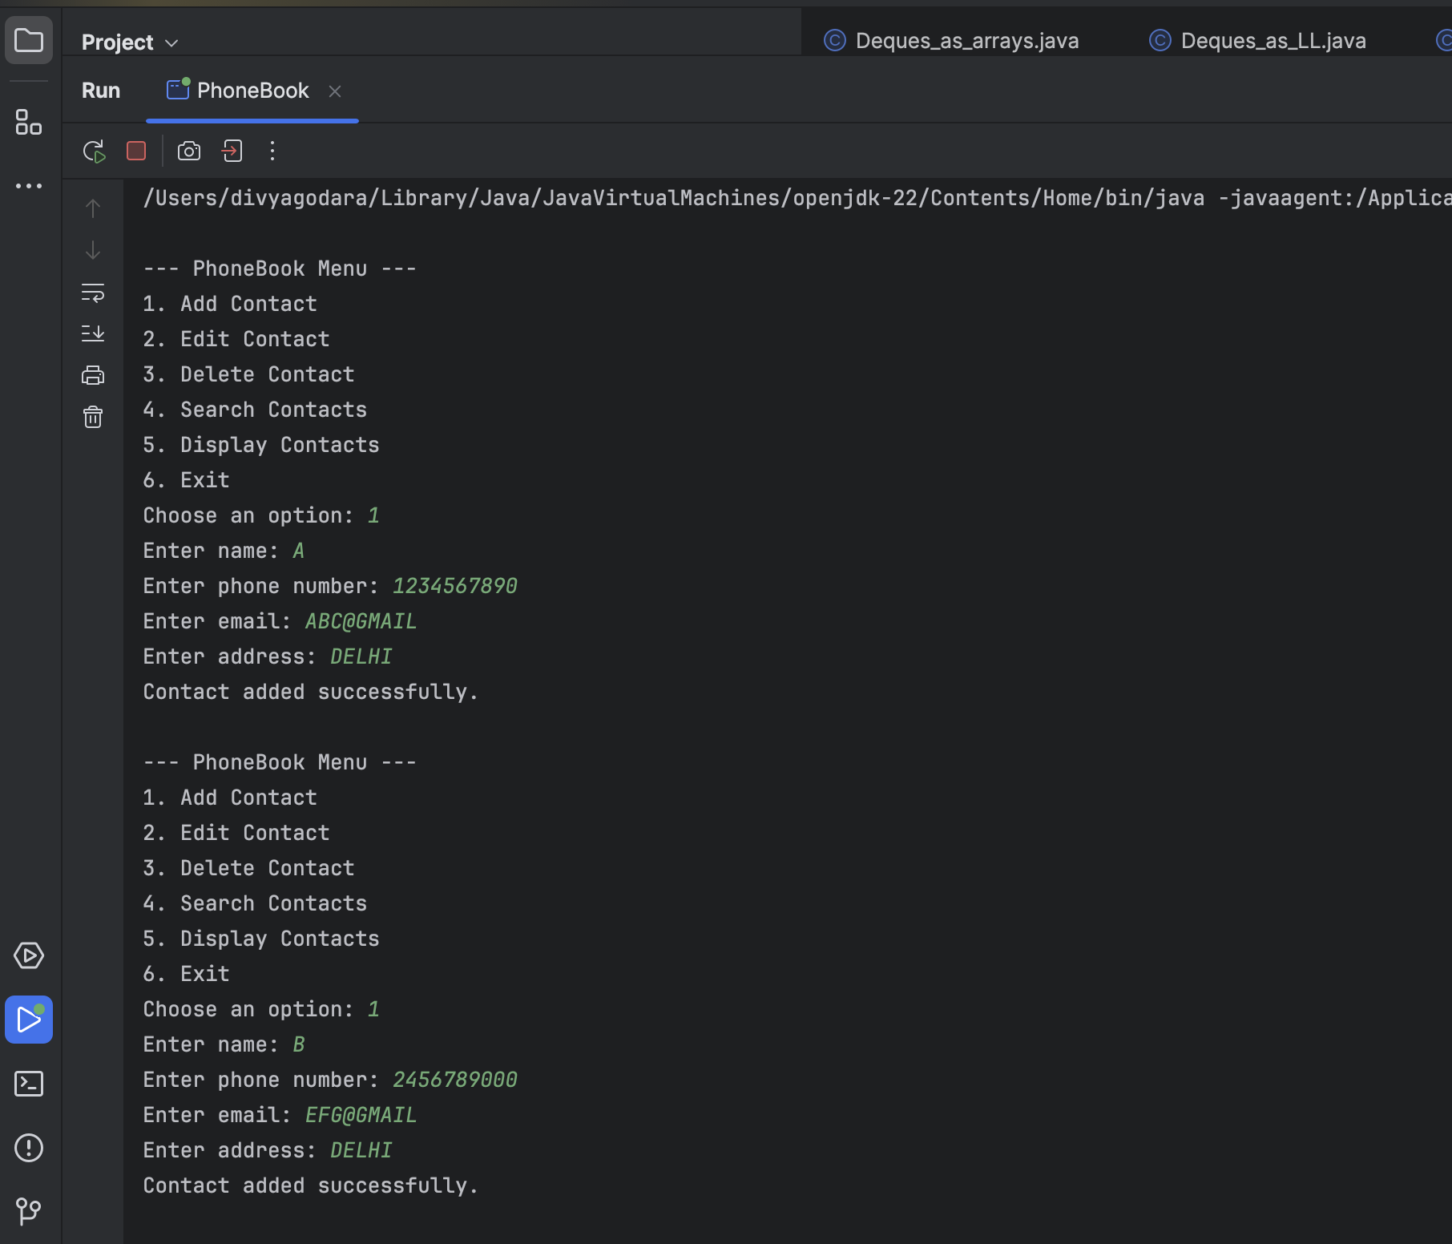
Output :

Slide 12
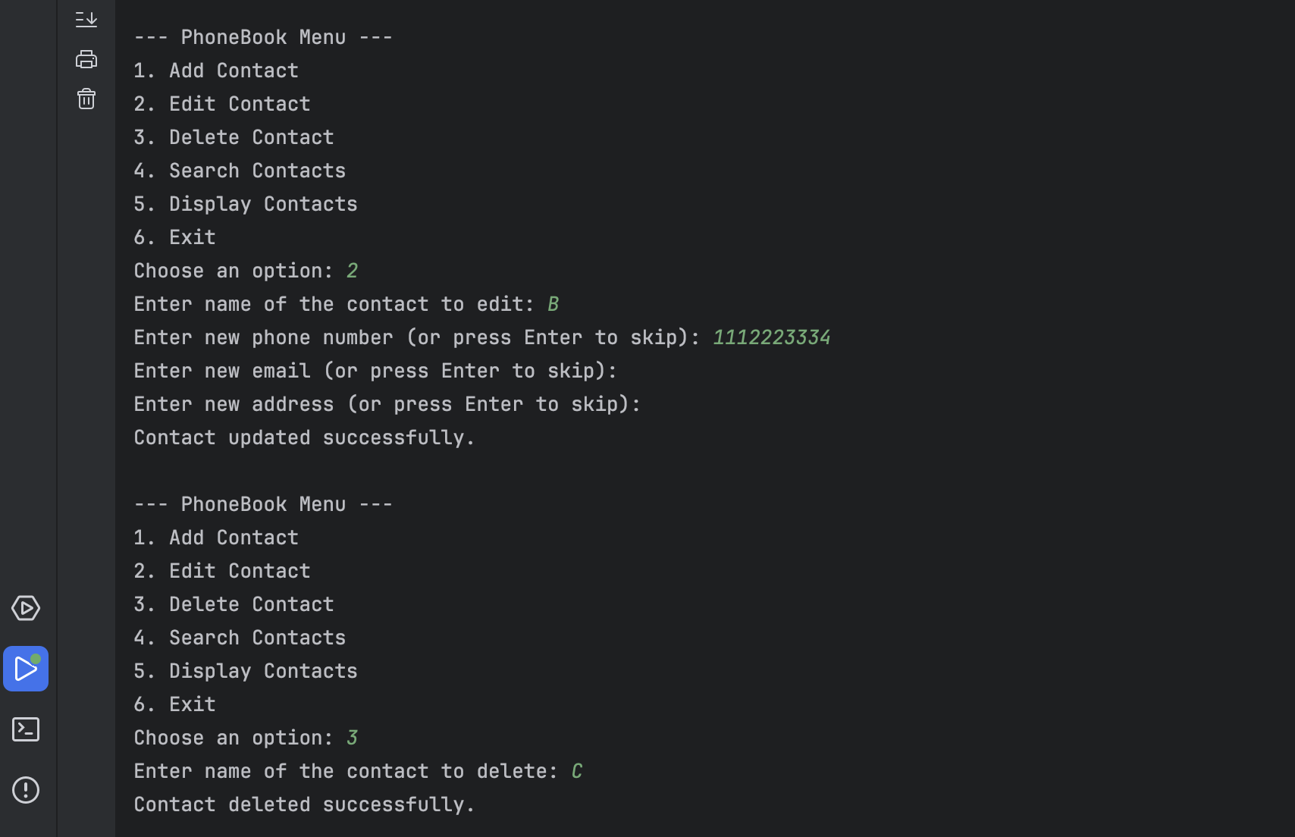

Slide 13
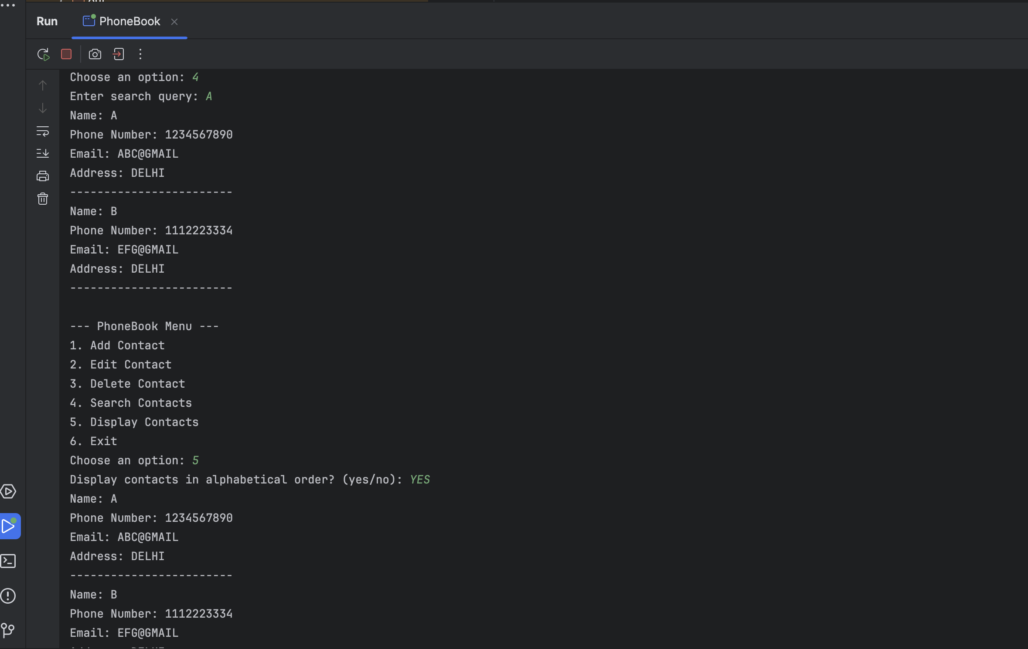

Slide 14


Thank You

